Slide 1
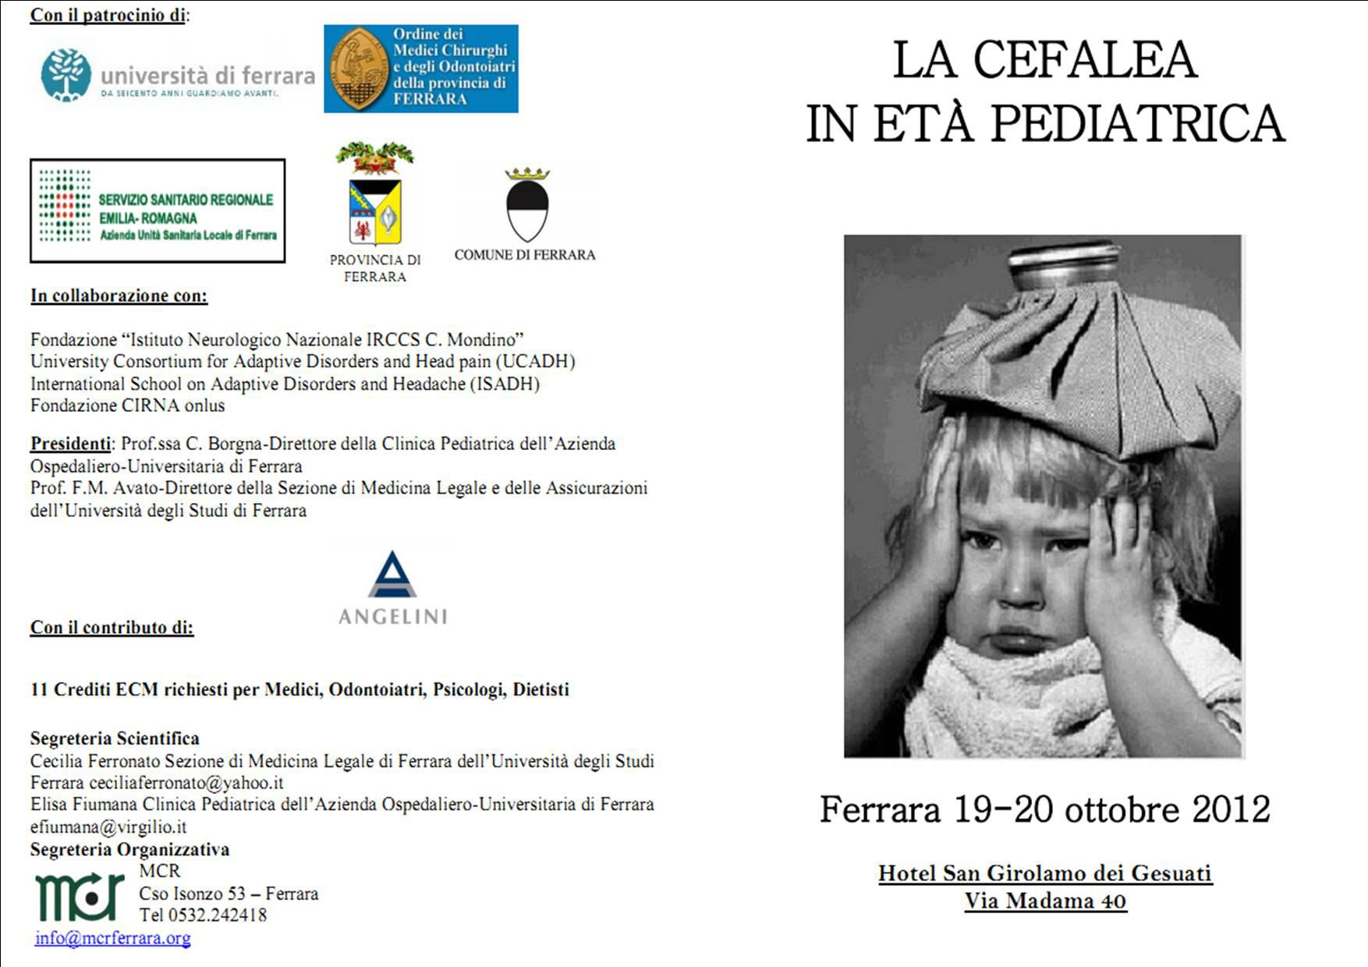
La cefalea e il dentista
Niki Arveda

Slide 2
Cefalea e
disordini temporomandibolari
La prevalenza dei TMD nella popolazione di soggetti affetti da cefalea è 56.1%
La prevalenza dei TMD tende ad essere più alta nei pazienti con combinazione di emicrania e cefalea di tipo tensivo
Pazienti con coesistenti TMD hanno una prevalenza di depressione significativamente maggiore
Ballegaard V, Thede-Schmidt-Hansen P, Svensson P, Jensen R.
Are headache and temporomandibular disorders related? A blinded study.
Cephalalgia. 2008 Aug;28(8):832-41.

Slide 3
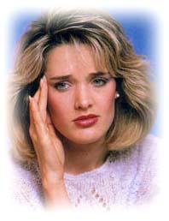
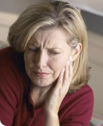
Disordini temporomandibolari
“… è un termine collettivo che comprende diversi problemi clinici che coinvolgono i muscoli masticatori,
l’articolazione temporomandibolare, e
le strutture associate, o entrambi.”

Slide 4
Disordini temporomandibolari
TRIADE SINTOMATOLOGICA:
rumore (click, scroscio)
dolore
limitazione
nei movimenti mandibolari

Slide 5

Limitazione funzionale
difficoltà a masticare alcuni cibi
prolungamento della durata del pasto
alterazione delle abitudini alimentari
frustrazione secondaria
Segu’ M, Lobbia S, Canale C, Collesano V.
Quality of life in patients with temporomandibular disorders.
Minerva Stomatol. 2003 Jun;52(6):279-87.

Slide 6
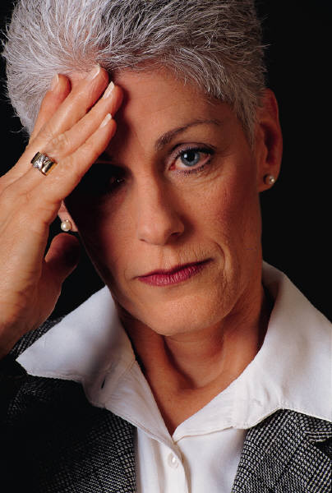
Sfera emotiva
Disagio psicologico (preoccupazione, disturbi del sonno, tensione e difficoltà a rilassarsi)
Meccanismi psicologici e comportamentali possono essere fattori predisponenti e/o perpetuanti dei disturbi.
Segu’ M, Lobbia S, Canale C, Collesano V.
Quality of life in patients with temporomandibular disorders.
Minerva Stomatol. 2003 Jun;52(6):279-87.

Slide 7

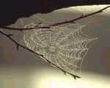
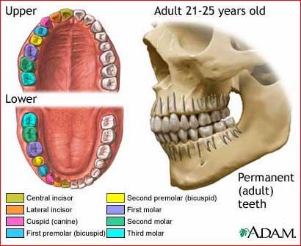
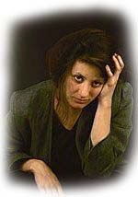
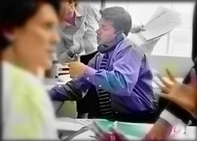
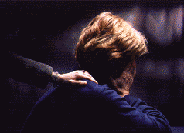
Disordini temporomandibolari
Etiologia biopsicosociale
Dougall AL, Jimenez CA, Haggard RA, Stowell AW, Riggs RR, Gatchel RJ. Biopsychosocial factors associated with the subcategories of acute temporomandibular joint disorders. J Orofac Pain. 2012 Winter;26(1):7-16.

Slide 8
Criteri Diagnostici di Ricerca
per i Disordini Temporomandibolari (RDC/TMD)
ASSE I
Gruppo I: disordini muscolari
Gruppo II: dislocazioni dl disco
Gruppo III: artralgia, osteoartrite, osteoartrosi
ASSE II
Stato di dolore cronico
Punteggio di depressione
Scala dei sintomi fisici non specifici
Limitazioni correlate al funzionamento mandibolare
Manfredini D, Segù M, Bertacci A, Binotti G, Bosco M.
Diagnosis of temporomandibular disorders according to RDC/TMD axis I findings,
a multicenter Italian study.
Minerva Stomatol. 2004 Jul-Aug;53(7-8):429-38.

Slide 9
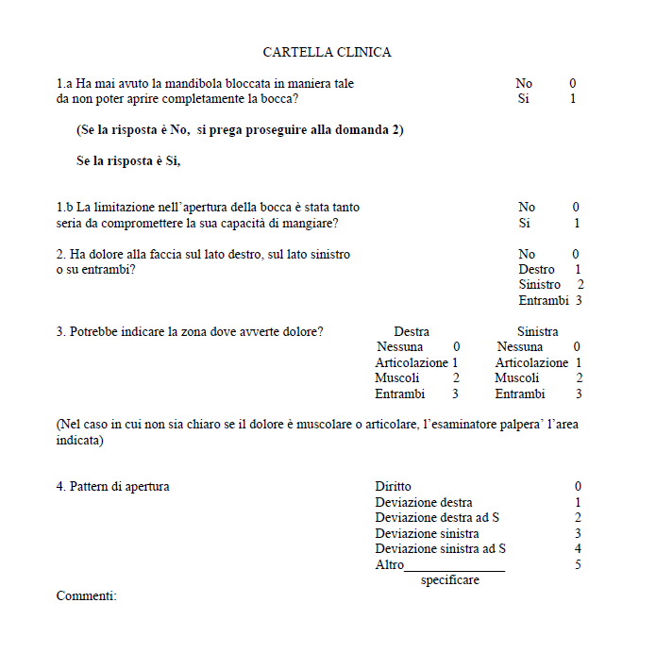
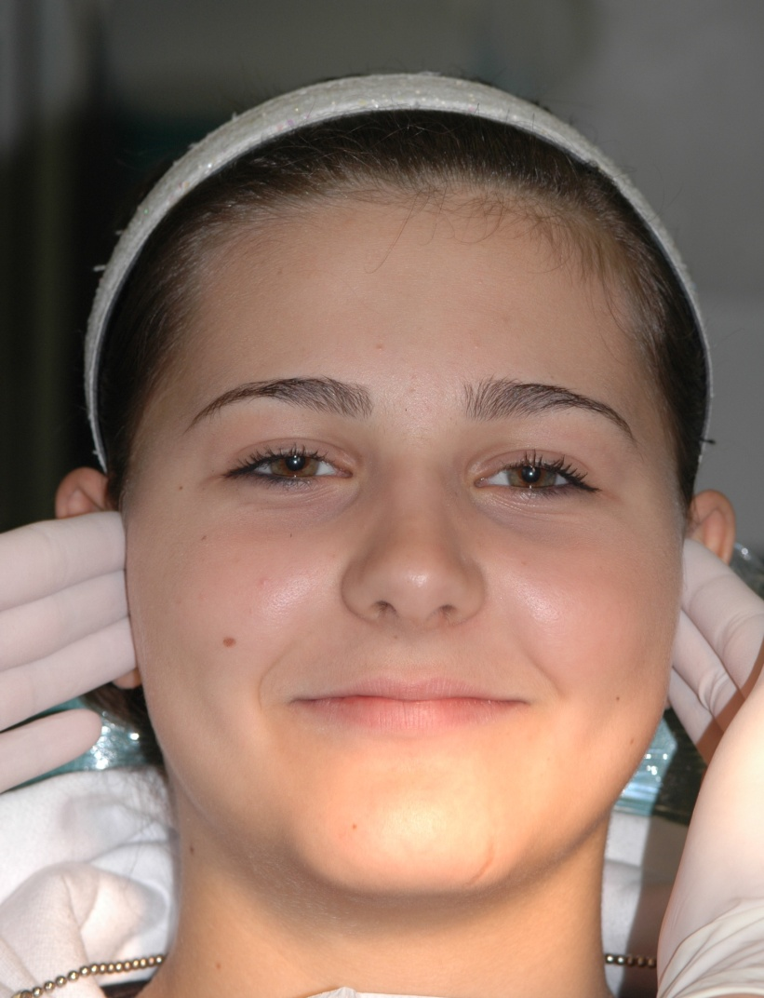
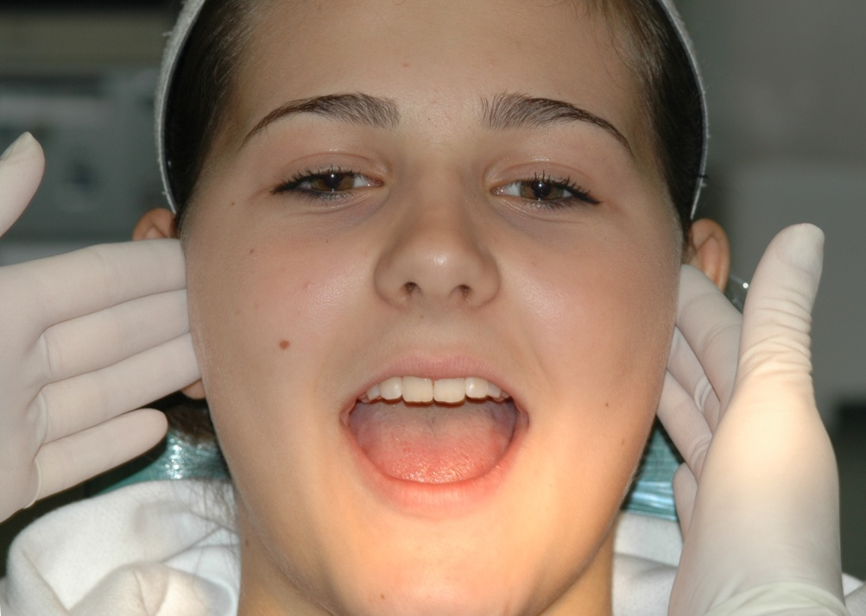
Criteri Diagnostici di Ricerca
per i Disordini Temporomandibolari (RDC/TMD)
Palpazione ATM

Slide 10
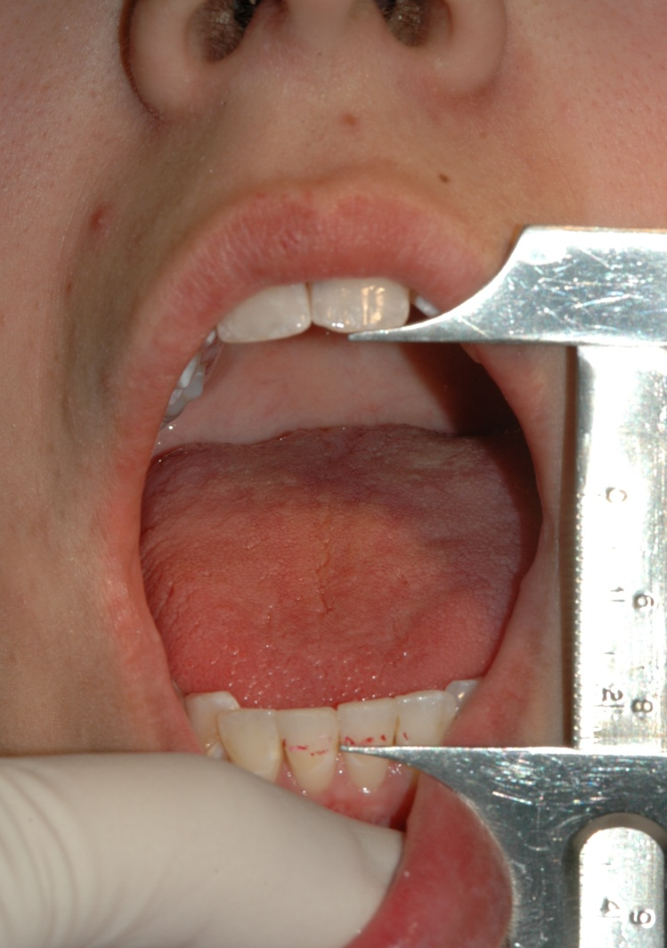
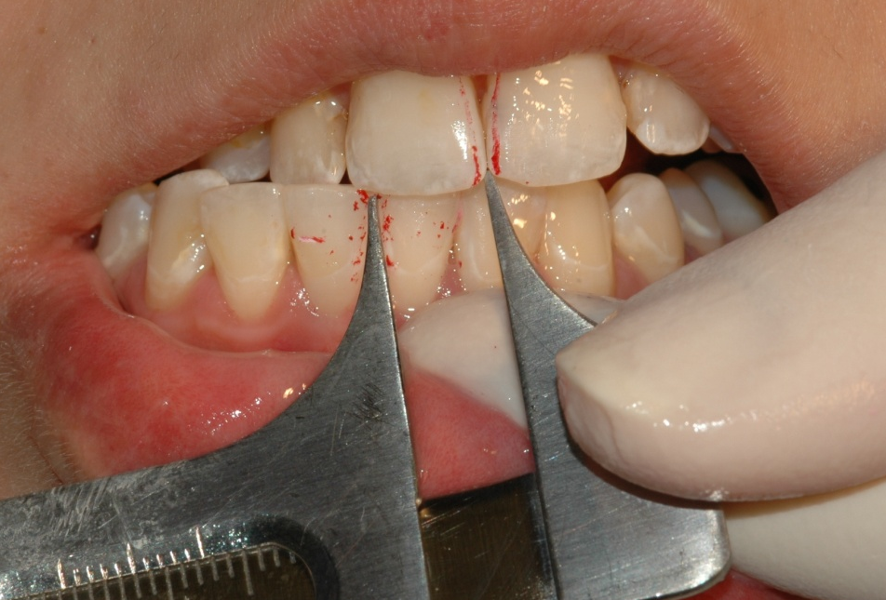
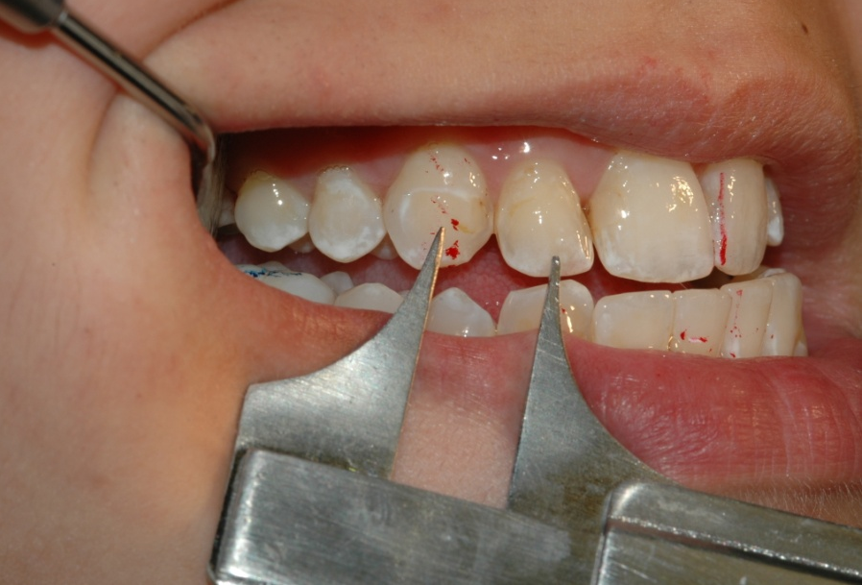
Criteri Diagnostici di Ricerca
per i Disordini Temporomandibolari (RDC/TMD)
Analisi qualitativa e quantitativa dei movimenti

Slide 11
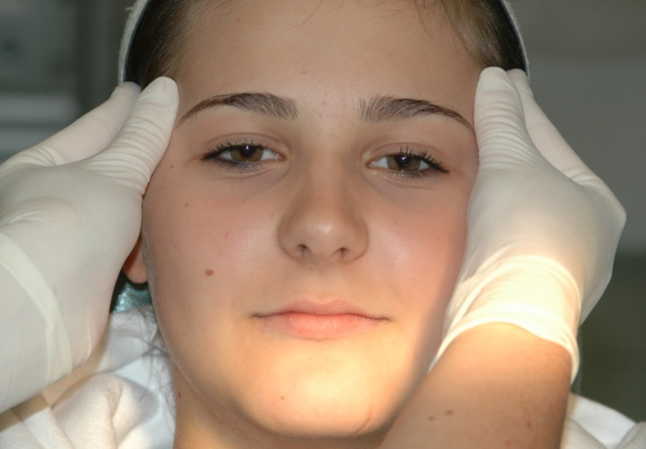
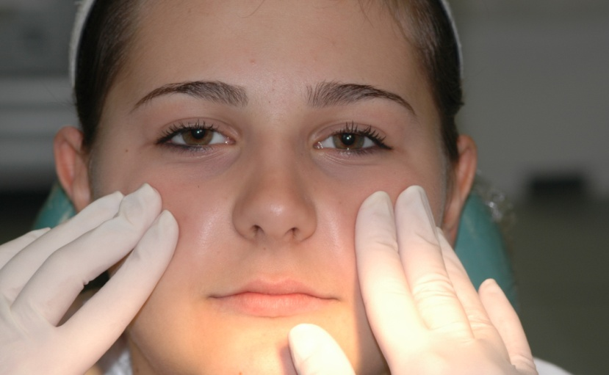
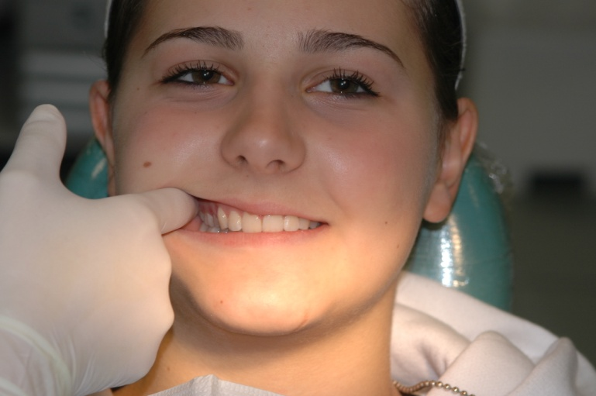
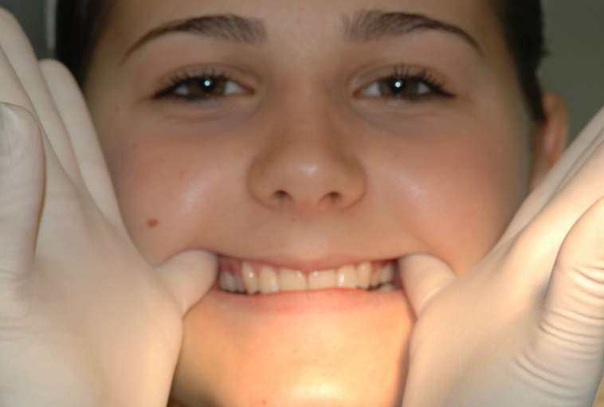
Criteri Diagnostici di Ricerca
per i Disordini Temporomandibolari (RDC/TMD)
Palpazione dei muscoli masticatori

Slide 12
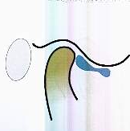
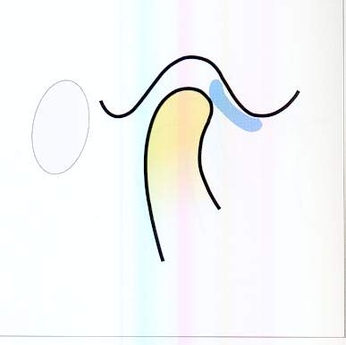
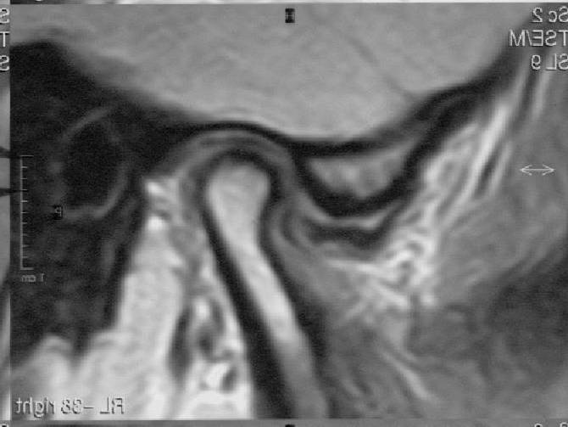
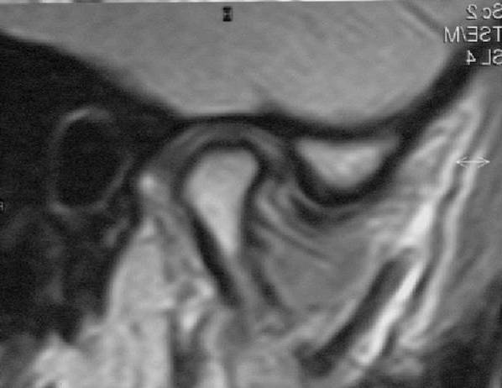
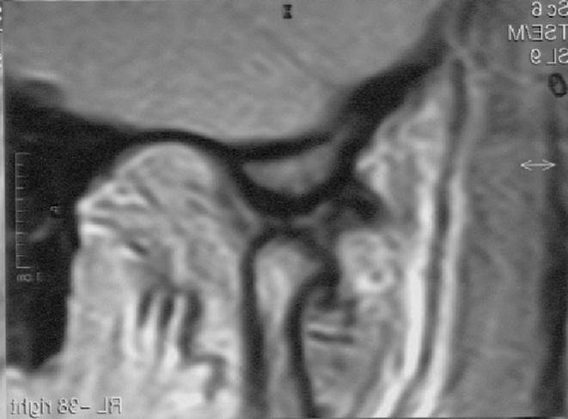
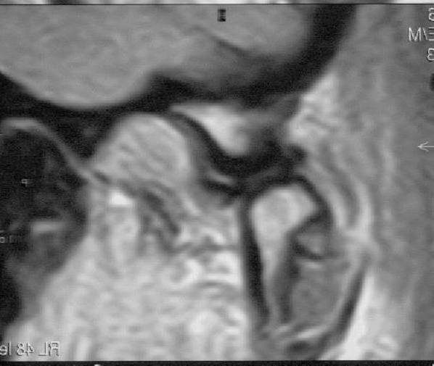
Valutazione strumentale di segni e sintomi di disfunzione stomatognatica
Ogura I. Magnetic resonance imaging characteristics of temporomandibular joint pain during opening and biting in patients with disc displacement.
Oral Surg Oral Med Oral Pathol Oral Radiol Endod 2006;102:669-72.

Slide 13
Management clinico
MULTIDISCIPLINARE
“TAILORED”
REVERSIBILE
LOW-TECH
HIGH-PRUDENCE
STEPPED CARE
CBT
Terapia
Fisica e
fisioterapia
Farmacoterapia
Bite e altre
terapie occlusali
Chirurgia
mini-invasiva
Chirurgia maior
CAM
TMD
Laskin DM, Greene CS, Hylander WL. Temporomandibular disorders: An evidence-based approach to diagnosis and treatment.
Quintessence Publishing Co, Inc 2006.

Slide 14



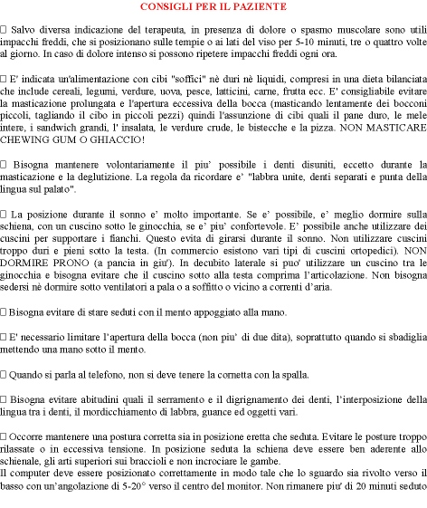
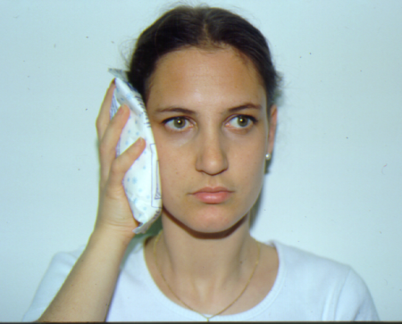
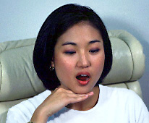


http://www.aahnfp.org/

Slide 15
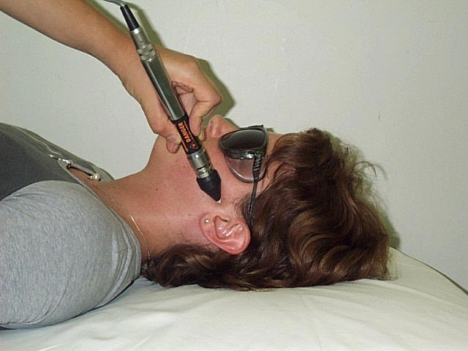
Terapia fisica
MODALITA’
    Termoterapia
      Crioterapia
      Calore
    Laserterapia
    Ultrasuonoterapia
    Elettroterapia
      TENS
      MENS
      Stimolazione galvanica
    Elettromagnetoterapia
    Agopuntura
    Biofeedback
Michelotti A, De Wijer A, Steenks M, Farella M. Home-exercise regimes for the management of non-specific temporomandibular disorders. J of Oral Rehabil 2005 32; 779–785.
Salmos-Brito JA, de Menezes RF, Teixeira CE, Gonzaga RK, Rodrigues BH, Braz R, Bessa-Nogueira RV, de Martínez Gerbi ME. Evaluation of low-level laser therapy in patients with acute and chronic temporomandibular disorders. Lasers Med Sci. 2012 Feb 25.

Slide 16
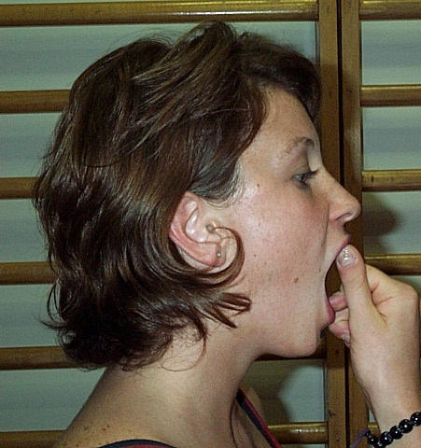
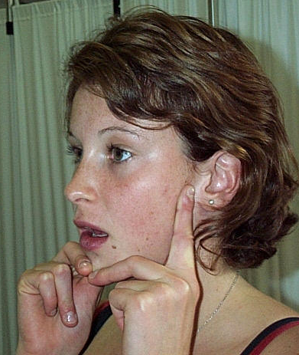
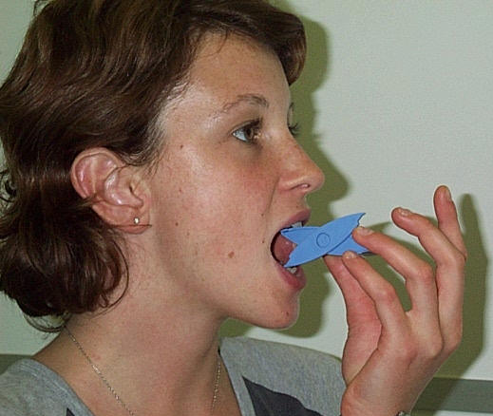
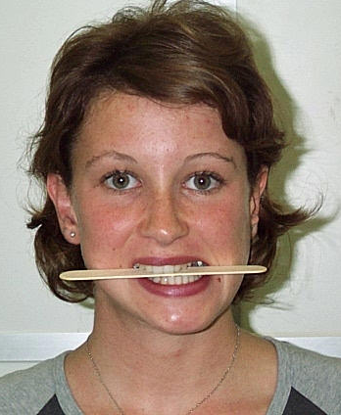
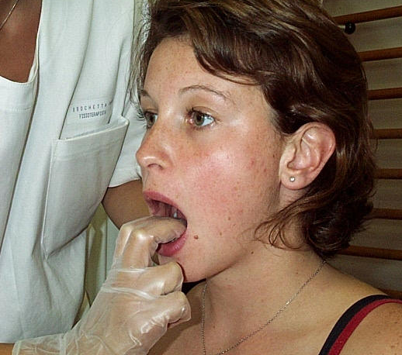
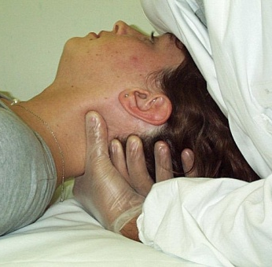
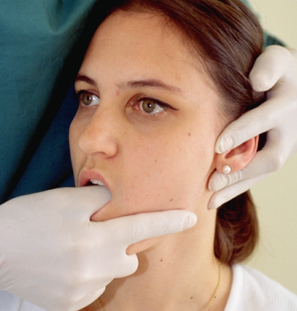
Fisiocinesiterapia
MODALITA’
Cinesiterapia passiva
Cinesiterapia attiva
  Cinesiterapia attiva assistita
  Cinesiterapia attiva vera
  Cinesiterapia attiva contro resistenza
Riequilibrio muscolare
Rieducazione neuromuscolare
Michelotti A, De Wijer A, Steenks M, Farella M. Home-exercise regimes for the management of non-specific temporomandibular disorders. J of Oral Rehabil 2005 32; 779–785.
Truelove E, Huggins KH, Mancl L, Dworkin SF. The efficacy of traditional, low-cost and nonsplint therapies for temporomandibular disorder: a randomized controlled trial. J Am Dent Assoc. 2006 Aug;137(8):1099-107.

Slide 17
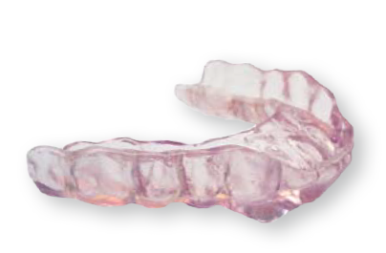
Terapia occlusale – bite
I bite sono efficaci nel ridurre la severità del dolore.
I bite di stabilizzazione – tipo placca Michigan – sono più efficaci rispetto ad altri presidi occlusali.
Al-Ani MZ, Davies SJ, Gray RJM, Sloan P, Glenny AM. Stabilisation splint therapy for temporomandibular pain dysfunction syndrome (Review).
Copyright © 2006 The Cochrane Collaboration. Published by John Wiley & Sons, Ltd.

Slide 18

CAM
News
http://nccam.nih.gov/clinicaltrials/tmd.htm
TMD RCT
National Center for Complementary and Alternative Medicine
Agopuntura
Terapia chiropratica
Terapia bodywork
Naturopatia
Medicina Tradizionale Cinese
Shamanic healing
DeBar LL, Vuckovic N, Schneider J, Ritenbaugh C. Use of complementary and alternative medicine for temporomandibular disorders. J Orofac Pain. 2003;17(3):224-36.
Schneider J, Vuckovic N, DeBar L. Willingness to participate in complementary and alternative medicine clinical trials among patients with craniofacial disorders.
J Altern Complement Med. 2003 Jun;9(3):389-401.

Slide 19
Orofacial pain: gendered brain
Risk factors for chronic OFP include chronic widespread pain, female gender, age and psychological factors, with most studies reporting that females report OFP twice as frequently as males.
Renton T, Durham J, Aggarwal VR. The classification and differential diagnosis of orofacial pain. Expert Rev. Neurother. 2012;12(5), 569–76.

Slide 20
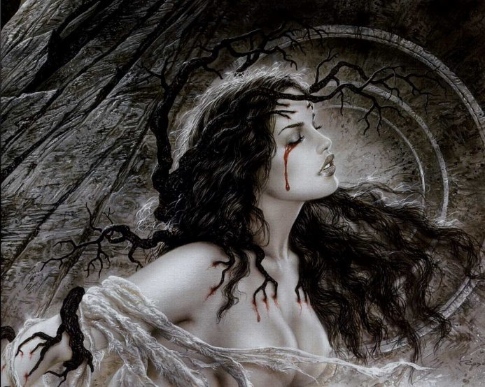
Gender medicine
Epidemiologic literatures suggest that temporomandibular joint disorders (TMD) are more prevalent in women than in men. The role of gender in TMD is likely multifactorial involving inherent physiological differences in gonadal hormones, stress reactivity, and inflammatory responses, as well as sociocultural differences in response to pain. Aim: to examine whether there is a gender-dependent risk profile for psychopathologic features (depression, non-specific physical symptoms, and graded chronic pain according to the Research Diagnostic Criteria for Temporomandibular Disorders (RDC/TMD) Axis II) in a TMD population sample.
Materials and methods: A sample of 308 (61 men and 247 women; mean age, 41 years) consecutive patients from a TMD clinic completed the Research Diagnostic Criteria for TMD (RDC/TMD) Axis II questionnaire. Axis II consents the psycho-social diagnosis in four reference values: 1) chronic pain grade classification subdivided in: grade 0 (no TMD pain in prior 6 months); grade I (low disability, low intensity); grade II (low disability, high intensity); grade III (high disability, moderately limiting); grade IV (high disability, severely limited); 2) score of depression (normal, moderate, severe); 3) score of somatization (nonspecific physical symptoms: normal, moderate, severe); 4) functional limitation.
Results: Graded chronic pain: 26% of the women has degree I, 36.4% degree II, 17% degree III, 9.7% degree IV. 34.4% of the men has degree I, 32.8% degree II, 6.5% degree III, 3.3% degree IV.
Depression: 14.1% of the woman has a moderate depression and 56% severe. 9.8% of the men has a moderate depression and 39.3% severe.
Somatization: 23.9% of the women has a moderated somatization, 58% severe; 32.8% men have moderated somatization, 31.1% severe.
Conclusions: Within the limitations of this study, female patients diagnosed with TMD has higher levels of depression and somatization than male patients. It was concluded that gender differences play a role in etiopathogenesis of TMD, as demonstrated by an increase in levels of depression and somatization in female patients.
Licini F, Nojelli A, Segù M, Collesano V. Gender differences in psychopathologic features of temporomandibular disorders. International Workshop Neurological Sciences and Gendered Brain. Pavia, April 23-24, 2009.

Slide 21
