Slide 1
La Farmacogenomica
Salvatore Terrazzino
Dipartimento di Scienze del Farmaco
Università del Piemonte Orientale
Ferrara, 19 ottobre 2012
Hotel San Girolamo dei Gesuati

Slide 2
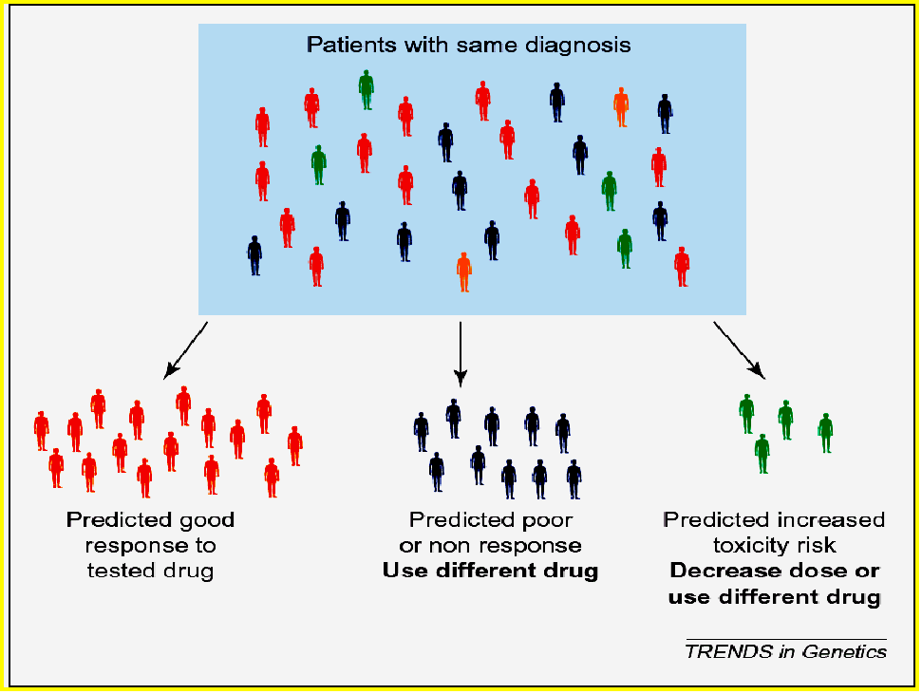
“One Size Doesn't Fit All”

Slide 5
Pharmacogenomics
Pharmacogenomics includes Pharmacogenetics

Slide 6
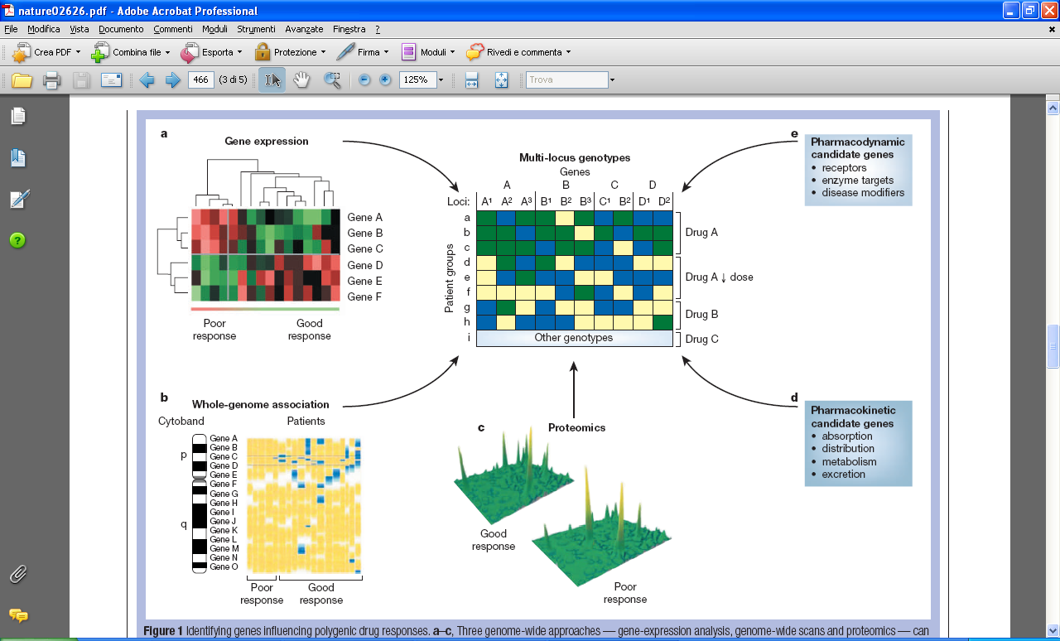
Identifying genes influencing polygenic drug responses
Evans and Relling, Nature 2004

Slide 9
Genetic Polymorphisms
Every gene contains some degree of polymorphism:
Base substitution, deletion or insertion
SNPs occurr every 100-300 base pairs throughout the genome
May be in coding or non-coding region
May alter amino acid (non-synonymous) or not (synonymous)
Polymorphisms can occur in:
Genes involved in drug pharmacokinetics that impact drug absorption, distribution, metabolism, and excretion
Drug targets (including cell surface receptors and target proteins)
Hormonal-regulated enzymes
Genetic polymorphisms can lead to enzyme products with:
abolished activity (gene deletions, premature stop codons, deleterious amino acid changes, exon skipping, abolished transcriptional start sites)
reduced or altered activity (promoter SNPs, minor AA substitutions, regulatory SNPs, VNTRs)
increased activity (overexpression due to gene duplication)

Slide 16
The Abacavir Example
HLA-B*5701 Presence
According to Patch test
Prospective Randomized Trial of
HLA-B*5701 Screening (PREDICT-1)

Slide 17
WARFARIN

Slide 18
Regression equation for modeling warfarin daily dose
requirements based on age, genotype, and height
Sconce EA, et al. Blood 106: 2329-2333, 2005

Slide 20
TRIPTANS: 5-HT_{1B/1D} RECEPTOR AGONISTS
Triptans provide:
Rapid onset of action
High efficacy
Favorable side effect profile
Approximately 25% of all migraine users and 40% of all attacks
do not respond to triptan treatment

Slide 21
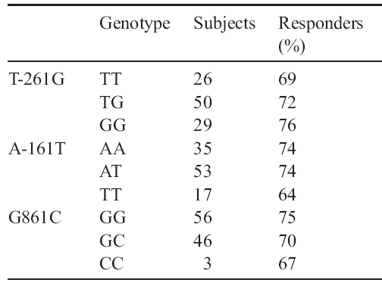
Triptan non-responders
Not able to treat early
Low and inconsistent oral absorption
Unrecognized analgesic overuse
Medical and psychiatric co-morbidities
5-HT_{1B/1D} receptor polymorphisms ?
Lack of association with common polymorphisms of 5-HT1B
receptor gene and triptan response in migraine patients
Velati D., Genazzani AA et al., Eur J Pharmacol. 2008; 580:43-47
Notes:
21

Slide 22
Metabolic pathways involved in the metabolism of triptans
Notes:
Triptan differ in their metabolic pathways. Indeed, sumatriptan and rizatriptan are metabolized only by MAO-A, whereas eletriptan, naratriptan and frovatriptan are metabolized only by cytochrome P450 enzymes.

Slide 23
COMT val158met polymorphism affects headache response to triptans
I cohort: MwoA patients and response to frovatriptan
II cohort: migraine patients and response to other triptans
Terrazzino et al., in preparation

Slide 24
Potential benefits of Pharmacogenomics
in the drug development process
– Identification of new drug targets
– Reduction of sample size and simplification of clinical trials
– Decrease in discontinuation of clinical trials due to unexpected ADRs
– Rise in rate of successful drug development
– Time for drug approval
…and in the clinical practice
– Earlier identification and selection of responder/non responder patients
–Estimation of dose optimal for particular patient based on genomic information
– Number of adverse drug reactions
– Number of medications to find effective therapy
– Decrease in the overall cost of Health Care

Slide 25
Challenges for clinical implementation of Pharmacogenomics
Providing scientific evidence for improvement in patient care by PGx testing
Providing data on diagnostic test criteria of PGx testing
(sensitivity, specificity, PPV, NPV, R²)
Providing informations on cost-effectiveness of PGx testing
Developing guidelines directing the clinical use of PGx test results
Improving education of healthcare professionals
Counseling services associated with genetic information

Slide 26
Predictive Medicine and Personalised therapy
“the right drug at the right dose in the right patient at the right time”

