Slide 1
Escissione Totale del Mesoretto: Laparotomia vs Laparoscopia
Carlo Feo

Slide 2
Curative resection
Wide resection of the cancer by achieving histologically negative margins
Total mesorectal excision (TME) and resection of local lymph nodes with sphincter-sparing procedures if it is possible to obtain a negative distal margin

Slide 3
TME
Removal of the rectum and perirectal areolar tissue (mesorectum) as one lymphovascular structure within an intact fascia propria¹
Standard surgical approach for APR or sphincter-sparing procedure
Conclusevely shown to ↓ local recurrence and ↑ rate of survival²
© 2012 UpToDate
¹Heald RJ. J R Soc Med 1988
²Heald RJ et al. Arch Surg 1998
Notes:
Principles of TME are as follows.
1. Sharp separation of the loose areolar tissue between the presacral fascia (Waldeyer’s fascia) and the investing fascia of the mesorectum (holy plane) posteriorly under direct vision together with the excision of the lateral
ligaments; however, the anterior separation is performed between the rectum and the prostate through the Denonvillier’s fascia in men or rectovaginal fascia in women;
2. High ligations of the inferior mesenteric artery and vein;
3. Excision of the distal mesorectum of not less than 5 cm; in distal rectal cancers (ie, 5 cm from the anal verge), a negative distal bowel margin of 1 to 2 cm may be acceptable; this should be confirmed to be tumor-free by
frozen section;
4. Preoperative evaluation of tumor stage and postoperative analysis of the quality of the excised specimen;
5. Preservation of the pelvic autonomic nerve plexus thus maintaining bladder and sexual functions, which are primordial to the postoperative quality of life.

Slide 4
Principles of TME
Sharp separation of loose areolar tissue between presacral and investing fascia of the mesorectum (holy plane) posteriorly; excision of the lateral ligaments; anterior separation between the rectum and the prostate in men or rectovaginal fascia in women;
High ligations of the inferior mesenteric artery and vein;
Excision of the distal mesorectum of ≥5 cm; in distal rectal cancers (≤5 cm), a negative distal margin of 1-2 cm may be acceptable; this should be confirmed to be tumor-free by frozen section;
Preoperative evaluation of tumor stage and postoperative analysis of the quality of the excised specimen;
Preservation of the pelvic autonomic nerve plexus thus maintaining bladder and sexual functions

Slide 5
Outline
Potential benefits of laparoscopic approach
Oncologic outcomes
Short-term and functional outcomes
Postoperative complications
Cost-benefit in Italy

Slide 6
Potential benefits
Superior view (better visualization of nerves in the pelvis)
Abdominal wall trauma ↓
Postoperative pain ↓
Postoperative ileus ↓
Length of hostpital stay ↓
Protection of immune function

Slide 7
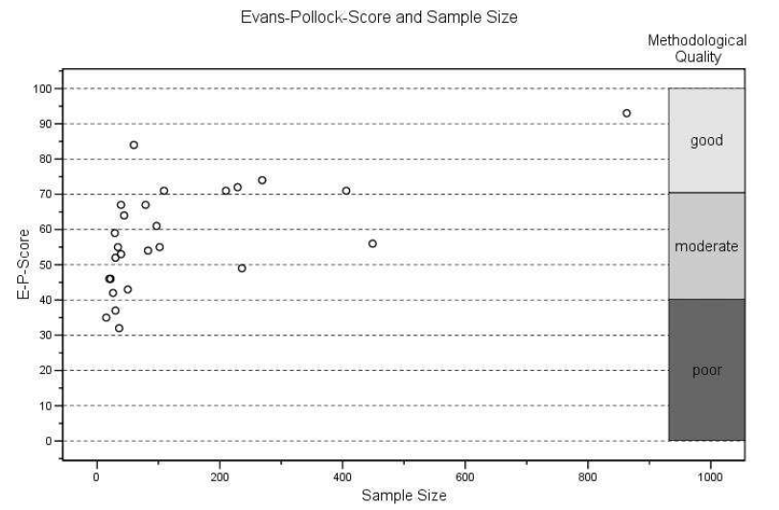

Slide 9
Oncologic outcomes
Number of lymph nodes retrieved
Adequacy of circumferencial radial margins
Recurrence rates
Disease-free survival
Overall survival

Slide 10
N lymph nodes retrieved
CRM
Notes:
RCTs 6

Slide 11
Overall recurrence
Local recurrence
Notes:
12 RCTs; N = 2095 | 1096/999

Slide 12
Disease-free survival at 3 years
Disease-free survival at 5 years

Slide 13
Overall mortality
Cancer-related mortality

Slide 14
Short-term outcomes
Operative time
Blood loss
Number of transfused patients

Slide 15
Operative time
Blood loss
Number of transfused patients

Slide 16
Functional outcomes
Duration of popstoperative ileus
Time to oral diet
Hospital stay

Slide 17
Ileus
Time to oral diet
Hospital stay

Slide 18
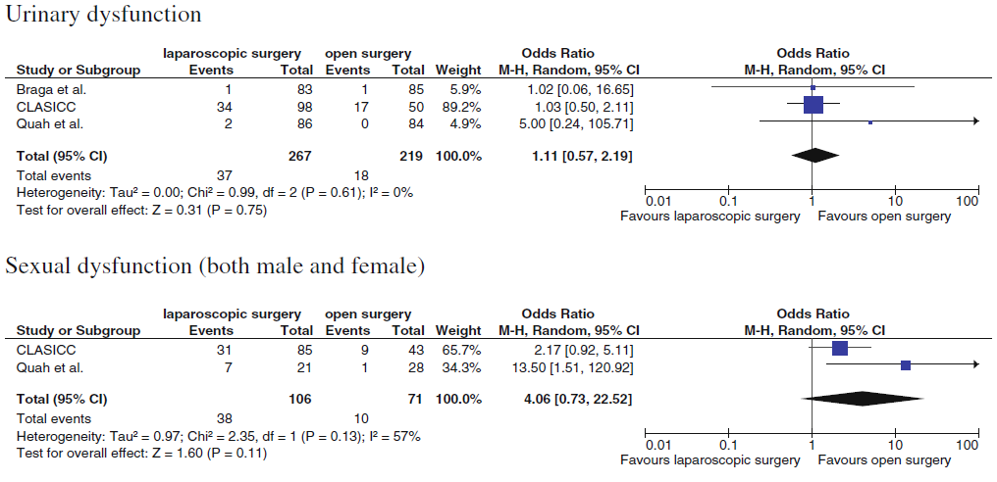

Slide 19
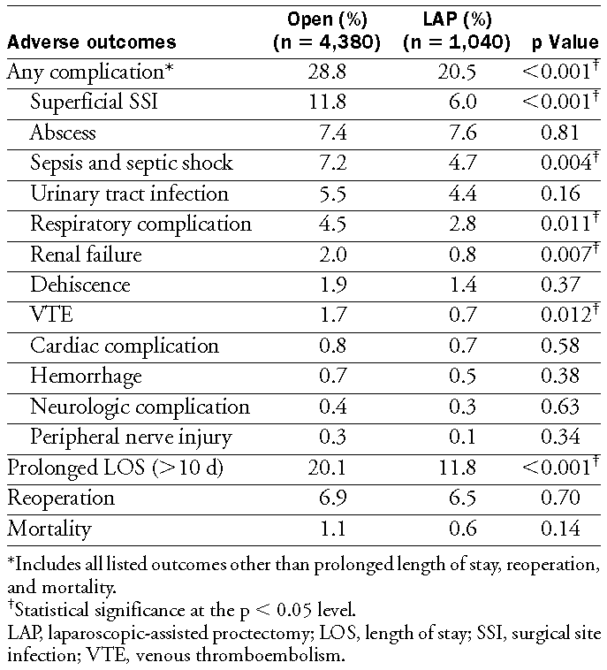

Slide 20
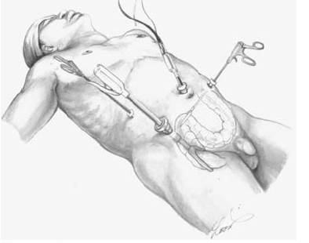
Anastomotic leaks
TME ↓ local recurrence rate, but devascularize the rectal stump and ↑ anastomotic leakage
Narrow confines of the bony pelvis (especially in men) may preclude the use of current stapling technology
Multiple firings often occur, resulting in overlapping staple lines¹ (“hybrid technique”²)
¹ Ito M et al. Int J Colorectal Dis 2008
²Vithiaranthan S et al. Dis Colon Rectum 2001
Notes:
The addition of TME reduces the local recurrence rate, but the complete removal of mesorectum down to the pelvic floor will cause devascularization of the rectal stump and increase anastomotic leakage. The narrow
confines of the bony pelvis (especially in men) sometimes precludes the use of current stapling technology in favor of obtaining an adequate distal transaction margin. Even when stapling is technically feasible, multiple firings of the laparoendoscopic stapling device often occur, resulting in overlapping staple lines. Concern exists regarding the potential hazards associated with crossing staple lines. One of several options in resolving this problem has been to perform a hybrid type of procedure entailing laparoscopic mobilization of the rectum, open distal transection with a transverse cutting stapling device via a lower midline incision (the length of a standard hand port), and subsequent end-to-end anastomosis (double-stapled technique or hand-sewn).

Slide 21
Anastomotic leaks
1-17% (∼10%) rate with selective diversion in high risk patients
All comparative studies and RCTs reported no statistically significant difference in the leakage rate
Gopall J et al. Am J Surg 2012

Slide 22
Methods
Results (extra charge/patient)
Surgical instruments
Operative room ($658/h)
Routine surgical care
Diagnosis and treatment of surgical complications
$1,194
$554
$647 saving
$749 saving (Total $66,164)

Slide 23
$1,396 overall saving per laparoscopic patient (↓ hospital stay and ↓ cost of complications)
$1,748 additional OR charges per laparoscopic patient
$351 extra cost per laparoscopic patient

Slide 24
Inflammatory responce
Citokines (IL-6, IL-8)
C-reactive protein
Immune status
White blood count
HLA-DR expression on monocyte
Stress responce
Cortisol
Prolactin
Growth hormone
Notes:
Leucocyte and monocyte counts, c-RP, IL-8, GH, Prolactin Cortisol.
Short-term postoperative immune and inflammatory functions tended to be better after laparoscopic rectal surgery. However, the differences were not consistent at all time intervals, making a definitive conclusion difficult. Better preserved inflammatory function 2 h after surgery may reflect a reduction in operative trauma when the laparoscopic technique is compared with open rectal procedures.

Slide 25
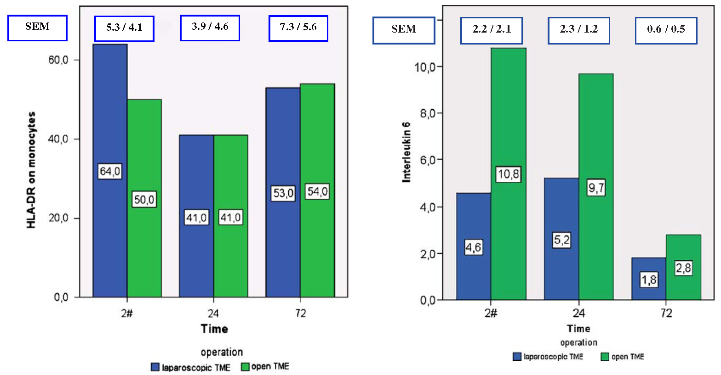
Notes:
Leucocyte and monocyte counts, c-RP, IL-8, GH, Prolactin Cortisol.
Short-term postoperative immune and inflammatory functions tended to be better after laparoscopic rectal surgery. However, the differences were not consistent at all time intervals, making a definitive conclusion difficult. Better preserved inflammatory function 2 h after surgery may reflect a reduction in operative trauma when the laparoscopic technique is compared with open rectal procedures.

Slide 26
Ongoing trials
European Colon Cancer Laparoscopic or Open Resection II trial (COLOR II)
Primary outcome: Locoregional recurrence rate at 3 years
Start 2004 | N=1100 | Completition April 2017
National Cancer Center, Korea (CTS-179)
Primary outcome: Disease-free survival at 3 years
Start 2006 | N=1100 | Completition August 2014
American College of Surgeons Oncology Group (ACOSOG)-Z6051 trial
Primary outcome: CRM > 1 mm; Negative distal resected margin; Completeness of TME
Start 2008 | N=650 | Completition November 2012
http:/clinicaltrials.gov

Slide 27
Summary
Laparoscopic approach is feasable and not inferior regarding oncologic results
Short-term outcomes are improved
Access and visibility are superior
Limited prospective data

Slide 28
Conclusions
Learning curve and technical difficulties recommend application of this approach in specialized centers with experienced advanced laparoscopic surgeons
Long-term results and larger RCTs are awaited

Slide 29
Thank You.

